Slide 1
Introduction to Statistical Methods
Descriptive Statistics
01-June-2019

Slide 2
Agenda
Measure of Central Tendency
Mean
Mode
Median
Measures of Variability
Range
Standard Deviation
Variance
Data Visualization
Why ?
What?
How ?
2

Slide 3
Statistical methods – basic approach
Data – Population – Sample –
Representation of data – Central tendency and variation
Univariate analysis
Bivariate and multi variate.
Univariate – Central tendency and variation (mean, variance)
Graphical – Histogram, Box plots .
Bivariate (Covariance, correlation matrices etc.,)
Selection of samples
Analysis of the sample data.
Fit a probability distribution.
Make suitable assumption on the population (variance of the population known)
Determine the required performance
Test for the performance with the sample data
How far the conclusions valid in the population

Slide 4
Descriptive statistics - Histogram
Discrete and continuous variables:
Discrete – If either possible values are from a finite set or infinite but can be ordered. Continuous if possible values can take any value in the entire line of real numbers.
Frequency – Number of times a value occurs
Relative frequency – Frequency / Total observations
In the continuous case, we have to split the values into intervals and plot the frequency in each interval in the Y axis.
If the width keeps shrinking, the histogram tends to be a continuous curve which is called density curve which’d later turn out to be a probability density curve.

Slide 5
Histograms Cont….
These are one of the most useful graphical technique in EDA.
These are bar plots of counts vs subgroups of an exposure variable
Each bar represents the frequency of the cases for the range of values.
This’d given an indication of the probability distribution.
Home work:
Exercise 1.9 in the reference book
Install R.
Use Hist and density command
See the results.

Slide 6
Measures of Central Tendency
Measures of Variability

Slide 7

Measures of Central Tendency
Measure of central tendency provides a very convenient way of describing a set of scores with a single number that describes the PERFORMANCE of the group.
Also defined as a single value that is used to describe the “center” of the data.
Three commonly used measures of central tendency:
Mean
Median
Mode

Slide 8
Mean
Also referred as the “arithmetic average”
The most commonly used measure of the center of data
Numbers that describe what is average or typical of the distribution
Computation of Sample Mean:
= Σ Y/ N = (Y1 + Y2 + Y3 + … Yn) / N where
“Y bar” equals the sum of all the scores, Y, divided by the number of scores, N.
Computation of the Mean for grouped Data
Where f Y = a score multiplied by its frequency

Slide 9
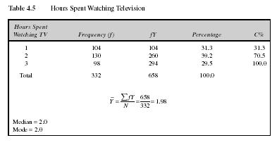
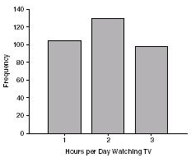
Mean: Grouped Scores
Data of Children watching TV in Bengaluru

Slide 10
Mean
Properties
It measures stability. Mean is the most stable among other measures of central tendency because every score contributes to the value of the mean.
It may easily affected by the extreme scores.
The sum of each score’s distance from the mean is zero.
It can be applied to interval level of measurement
It may not be an actual score in the distribution
It is very easy to compute.

Slide 11
Mean
When to Use the Mean
Sampling stability is desired.
Other measures are to be computed such as standard deviation, coefficient of variation and skewness

Slide 12
The Mode
The category or score with the largest frequency (or percentage) in the distribution.
The mode can be calculated for variables with levels of measurement that are: nominal, ordinal, or interval-ratio.
Example:
Number of Votes for Candidates for Lok Sabha MP. The mode, in this case, gives you the “central” response of the voters: the most popular candidate.
Candidate A – 11,769 votes The Mode:
Candidate B – 39,443 votes “Candidate C”
Candidate C – 78,331 votes
Notes:
For a nominal variable, the mode is the only measure that can be used.
For ordinal variables, the mode and the median may be used. The median provides more information (taking into account the ranking of categories.)
For interval-ratio variables, the mode, median, and mean may all be calculated. The mean provides the most information about the distribution, but the median is preferred if the distribution is skewed.

Slide 13
Mode
Properties
It can be used when the data are qualitative as well as quantitative.
It may not be unique.
It is affected by extreme values.
It may not exist.
When to Use the Median
When the “typical” value is desired.
When the data set is measured on a nominal scale

Slide 14
The Median
The score that divides the distribution into two equal parts, so that half the cases are above it and half below it.
The median is the middle score, or average of middle scores in a distribution.
Fifty percent (50%) lies below the median value and 50% lies above the median value.
It is also known as the middle score or the 50th percentile.

Slide 15
The Median
Median of Ungrouped Data
Arrange the scores (from lowest to highest or highest to lowest).
Determine the middle most score in a distribution if n is an odd number (and if n is an even number, get the average of the two middle most scores)

Slide 16
Median Exercise #1 (N is odd)
Calculate the median for this hypothetical distribution:
Job Satisfaction Frequency
Very High 2
High 3
Moderate 5
Low 7
Very Low 4
TOTAL 21

Slide 17
Median Exercise #2 (N is even)
Calculate the median for this hypothetical distribution:
Satisfaction with Health Frequency
Very High 5
High 7
Moderate 6
Low 7
Very Low 3
TOTAL 28

Slide 18
Median in Grouped Data
Where:
L = Lower boundary of the category containing the N/2
Cf = Cumulative frequency before the median class if the scores are arranged from the lowest to highest value
w = Size of the class interval
f = frequency of the median class

Slide 19
Median in Grouped Data
Steps to solve median for grouped data
Complete the table for Cf.
Get N/2 of the scores in the distribution so that you can identify MC
Determine L, w, f and Cf
Solve the median using the given formula

Slide 20
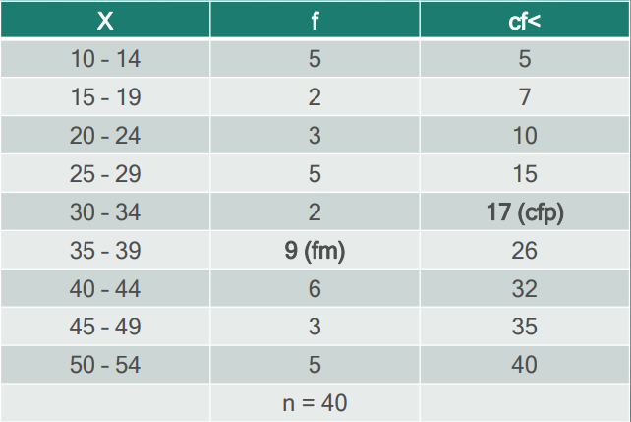
Median
Example: Scores of 40 students in a science class consist of 60 items and they are tabulated below. The highest score is 54 and the lowest score is 10.

Slide 21
Median
Solution:
n/2 = 40/2 = 20
The category containing n/2 is (35 – 39)
Lower Limit of MC = 35
L = 34.5
Cf (or Cfp) = 17
f (or fm) = 9
w = 5
Median = L + (n/2 – Cf) /f * w
= 34.5 +(20-17)/9 *5
= 34.5 + 15/9
= 36.17

Slide 22
Median
Properties
It may not be an actual observation in the data set.
Not affected by extreme values because median is a positional measure.
Can be applied in ordinal level.
When to Use the Median
The exact midpoint of the score distribution is desired.
There are extreme scores in the distribution.

Slide 23
Percentiles
A score below which a specific percentage of the distribution falls.
Finding percentiles in grouped data:

Slide 24
Shape of the Distribution
Symmetrical : mean is about equal to median
Skewed
Negatively : mean < median
Positively : mean > median
Bimodal : has two distinct modes
Multi-modal : has more than 2 distinct modes)
Notes:
Draw Examples on the board

Slide 25
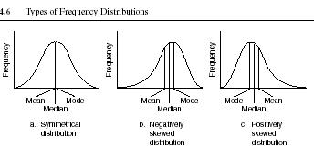
Distribution Shape

Slide 26
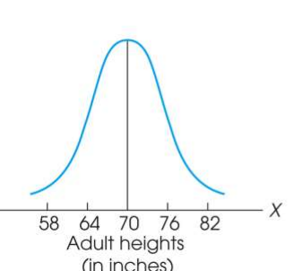
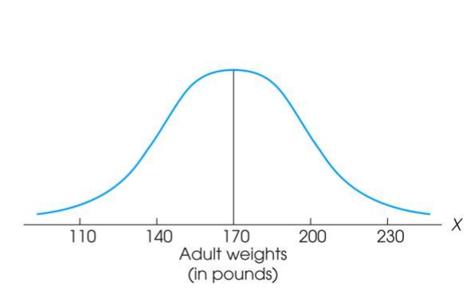
Measure of Variability
Variability can be defined several ways:
A quantitative distance measure based on the differences between scores
Describes distance of the spread of scores or distance of a score from the mean
Purposes of Measure of Variability:
Describe the distribution
Measure how well an individual score represents the distribution

Slide 27
The Three Measures
Three Measures of Variability:
The Range
The Variance
The Standard Deviations

Slide 28
The Ranges
The distance covered by the scores in a distribution – From smallest value to highest value
For continuous data, real limits are used
Based on two scores, not all the data – An imprecise, unreliable measure of variability
Range = URL for X_{max} - LRL for X_{min}
Example: For a set of scores: 7, 2, 7, 6, 5, 6, 2
Range = Highest Score minus Lowest score = 7 - 2 = 5

Slide 29
The Standard Deviation
Most common and most important measure of variability is the standard deviation
A measure of the standard, or average, distance from the mean
Describes whether the scores are clustered closely around the mean or are widely scattered
Calculation differs for population and samples
Variance is a necessary companion concept to standard deviation but not the same concept

Slide 30
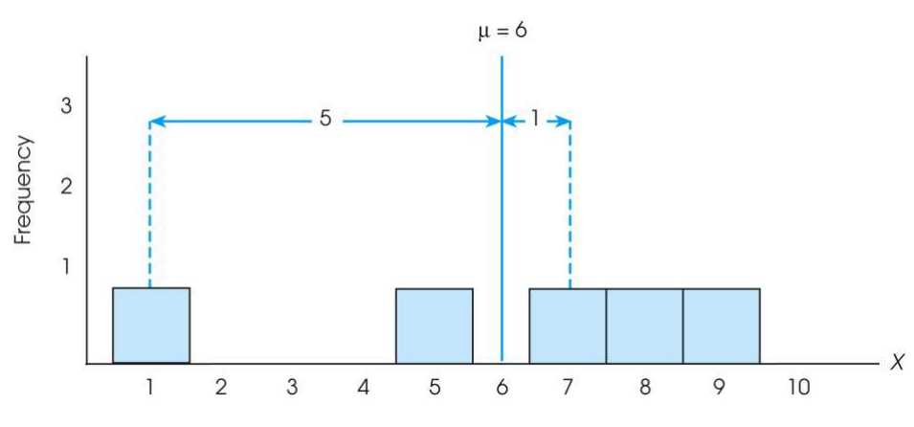
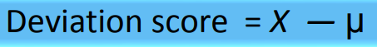
The Standard Deviation
Exercise : Find out the deviations of all the data points with the mean….and then find the ‘mean deviation’.

Slide 31

The Standard Deviation
Mean deviations will always be ‘zero’ !
(because Mean is a balance point)
Then, how do you find ‘Standard Deviation’ ?
Need a new strategy

Slide 32
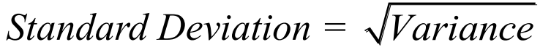
The Standard Deviation
New Strategy :
First square each deviation score
Then sum the Squared Deviations (SS)
Average the squared deviations
Mean Squared Deviation is known as “Variance”
Variability is now measured in squared units

Slide 33
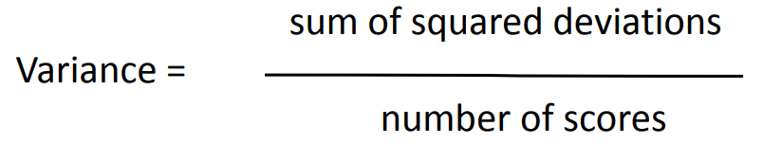
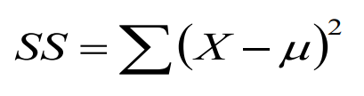
The Variance
Variance equals mean (average) squared deviation (distance) of the scores from the mean
where

Slide 34
The Population Variance
Population variance equals mean (average) squared deviation (distance) of the scores from the population mean
Variance is the average of squared deviations, so we identify population variance with a lowercase Greek letter sigma squared: σ ²
Standard deviation is the square root of the variance, so we identify it with a lowercase Greek letter sigma: σ

Slide 35
Learning Check
If all the scores in a data set are the same, the Standard Deviation is equal to 1.00
The standard deviation measures …
(1) Sum of squared deviation scores
(2) Standard distance of a score from the mean
(3) Average deviation of a score from the mean
(4) Average squared distance of a score from the mean
True / False ?
Select the correct option

Slide 36
Solution
If all the scores in a data set are the same, they are equal to the mean and hence the deviation from mean = 0 therefore, Standard Deviation is equal to zero
The standard deviation measures …
(1) Sum of squared deviation scores
(2) Standard distance of a score from the mean
(3) Average deviation of a score from the mean
(4) Average squared distance of a score from the mean
False

Slide 37
Standard Deviation and Variance for a Sample
Goal of inferential statistics:
Draw general conclusions about population
Based on limited information from a sample
Samples differ from the population
Samples have less variability
Computing the Variance and Standard Deviation in the same way as for a population would give a biased estimate of the population values

Slide 38
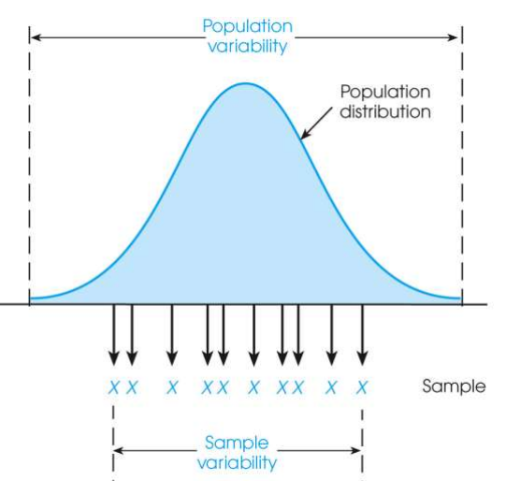
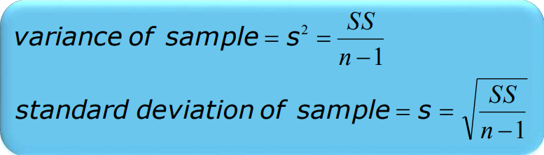
Sample Standard Deviation and Variance
Sum of Squares (SS) is computed as before
Formula for Variance has n-1 rather than N in the denominator
Notation uses s instead of σ
Population of Adult Heights

Slide 39
Degrees of Freedom
Population variance
Mean is known
Deviations are computed from a known mean
Sample variance as estimate of population
Population mean is unknown
Using sample mean restricts variability
Degrees of freedom
Number of scores in sample that are independent and free to vary
Degrees of freedom (df) = n – 1

Slide 40
Proof for using n-1 as divisor for variance
S² represents the sample variability.
But the population variability should be certainly more.
When the population is finite, the formula is
SS / N and not SS/(n-1)
where
When the Mu is not known, we are using Xbar.
All X(i) is will be closer to Xbar than Mu.
To compensate for that we replace N by N-1. which essentially represents the degrees of freedom since the knowledge of average fixes one variable out of N variables.

Slide 41
Box Plots
The Box plots describes the features such as
Center
Spread
Extent and nature of departure from symmetry
Identification of outliers
Defn: Order the ‘n’ observations in the ascending order.
Separate the smaller and larger halves.
Lower fourth is the median of the smaller half and upper fourth is the median of the larger half.
Measure of spread = Upper fourth – lower fourth

Slide 42
Box plots
Data:
40, 52, 55,60, 70,75,85, 85,90,90, 92, 94, 94, 95, 98, 100, 115,125, 125
Number of data elements: 19
Center 90
Lower Half 72.5
Upper Half 96.5
Q1 – 70
Q3 – 98
Any observation farther than 1.5fs from the closest fourth is an outlier. It is extremes if it is 3fs or more else mild.

Slide 43
Learning Check
Select the correct option
A sample of four scores has SS = 24. What is the variance?
The variance is 6
The variance is 7
The variance is 8
The variance is 12
A sample systematically has less variability than a population
The standard deviation is the distance from the Mean to the farthest point on the distribution curve
True / False ?
True / False ?

Slide 44
Solution
Select the correct option
A sample of four scores has SS = 24. What is the variance?
The variance is 6
The variance is 7
The variance is 8
The variance is 12
Extreme scores affect variability, but are less likely to be included in a sample
The standard deviation extends from the mean approximately halfway to the most extreme score
True
False

Slide 45
Sample Variance as an Unbiased Statistic
Unbiased estimate of a population parameter
Average value of statistic is equal to parameter
Average value uses all possible samples of a particular size n
Corrected standard deviation formula (dividing by n-1) produces an unbiased estimate of the population variance
Biased estimate of a population parameter
Systematically overestimates or underestimates the population parameter
Means and standard deviations together provide extremely useful descriptive statistics for characterizing distributions

Slide 46
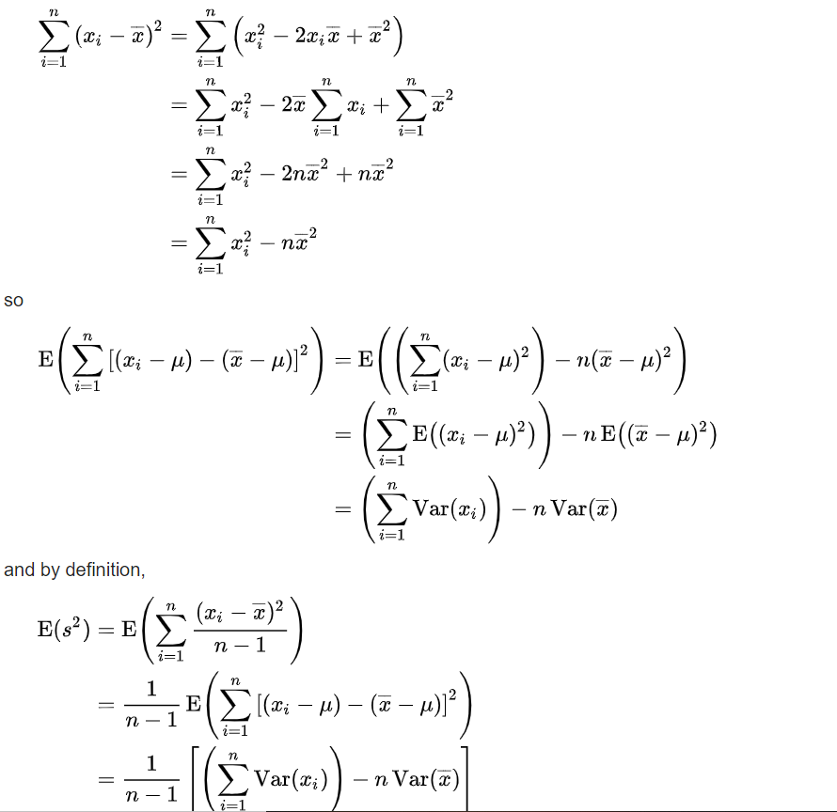
Rigorous proof

Slide 47
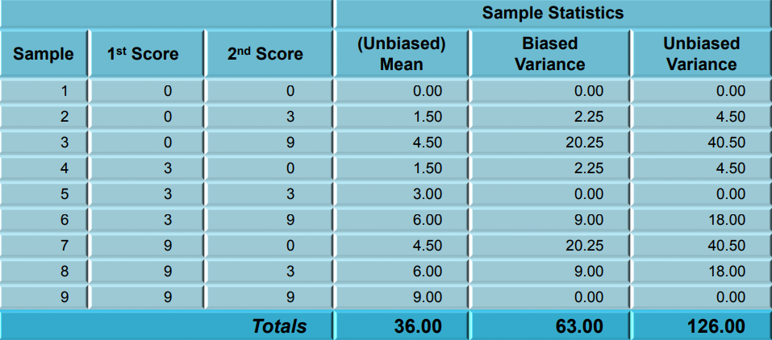
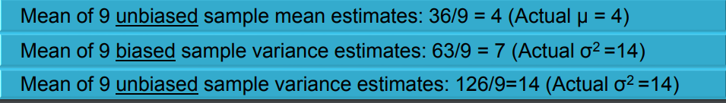
Biased and Unbiased Estimates

Slide 48
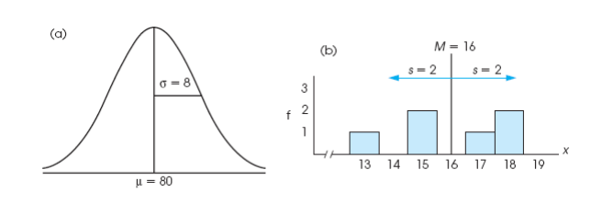
Descriptive Statistics
A standard deviation describes scores in terms of distance from the mean
Describe an entire distribution with just two numbers (M and s)
Reference to both allows reconstruction of the measurement scale from just these two numbers
Means and standard deviations together provide extremely useful descriptive statistics for characterizing distributions

Slide 50
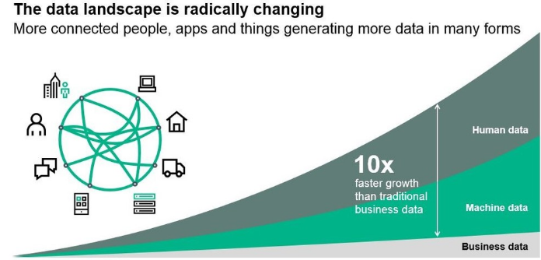
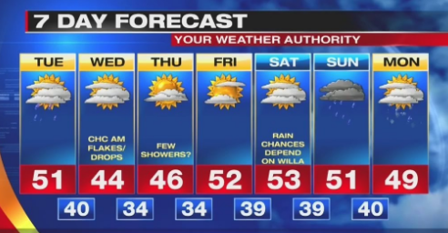
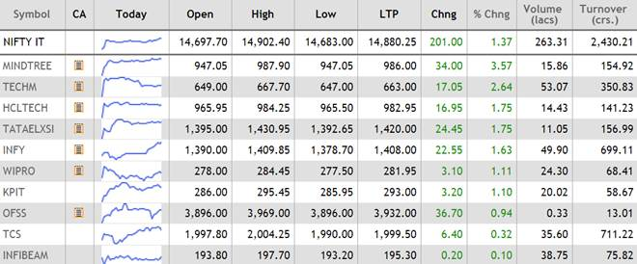
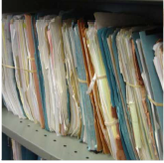
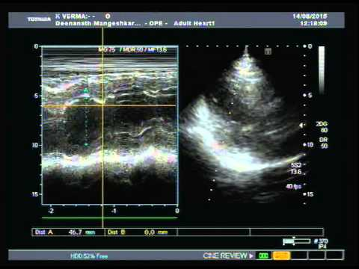
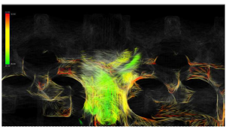
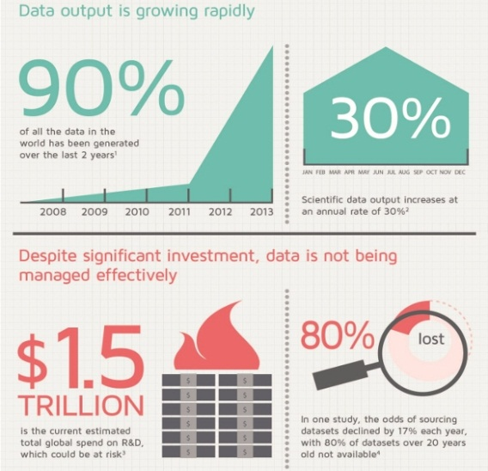

Data is generated everywhere …everyday …and is increasing exponentially
Source: http://3dsbiovia.com/blog/

Slide 51
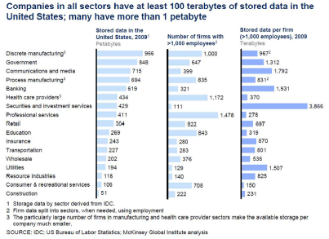

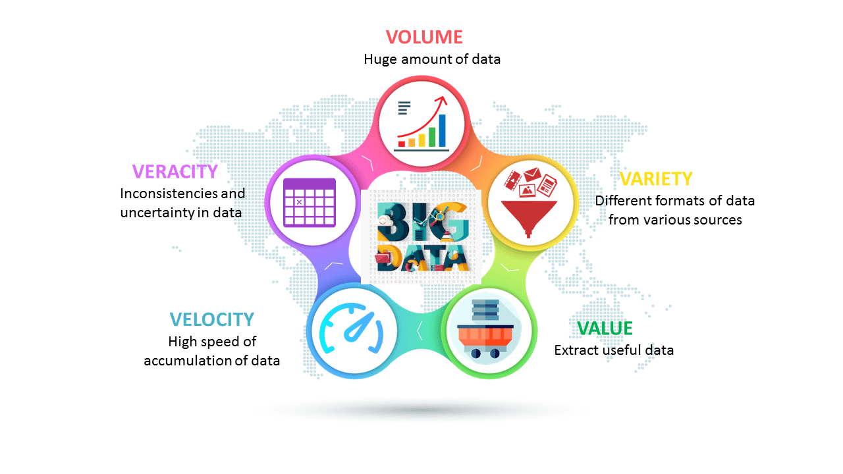
Data Has Become ‘Big ’
5 Vs of a data are ever increasing
➔ Need an effective way to understand them quickly
5 Vs of Big Data
Source: http://hedureka.com

Slide 52
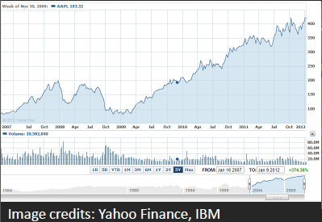
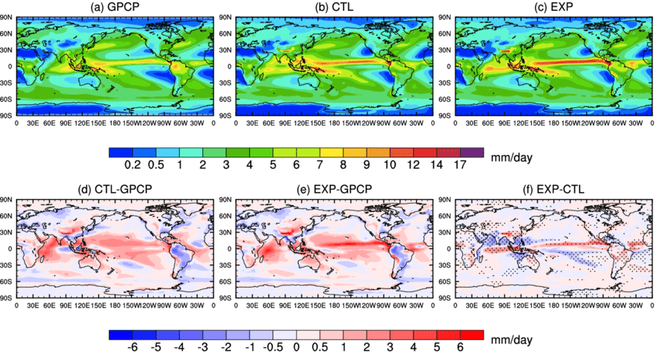
Data Visualization
Visual representation of data
For exploration, discovery , insight ….
Interactive component provides more insight as compared to static images
Image credits: www.researchgate.net

Slide 53
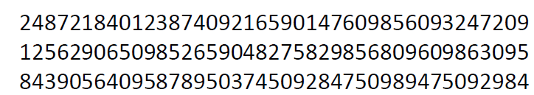
How many 3’s ?
How much time did you take ?
Image credits: www.researchgate.net

Slide 54
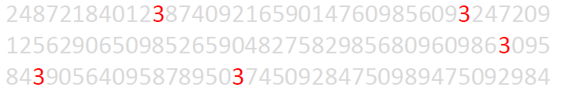
How many 3’s ?
How much time did you take now ?
Pre- attentive Processing:
• Requires attention despite the name
• Very fast: < 200-250 ms
• What matters most is the contrast between features

Slide 55
Highest sales figure for each product?
Annual Sales (in US $)
US States | Product A | Product B | Product C | Product D | Product E
Pennsylvania | 30,934.00 | 30,112.00 | 26,376.00 | 34,459.00 | 44,105.00
Illinois | 49,743.00 | 40,996.00 | 33,527.00 | 45,298.00 | 31,961.00
Ohio | 42,439.00 | 49,024.00 | 43,670.00 | 48,584.00 | 47,183.00
Georgia | 29,344.00 | 41,095.00 | 37,954.00 | 38,337.00 | 34,406.00
North Carolina | 30,443.00 | 31,941.00 | 29,231.00 | 49,090.00 | 41,067.00
Michigan | 41,241.00 | 36,036.00 | 43,715.00 | 34,026.00 | 32,050.00
New Jersey | 40,437.00 | 49,737.00 | 40,207.00 | 46,347.00 | 31,150.00
Virginia | 38,816.00 | 44,372.00 | 35,359.00 | 31,226.00 | 26,563.00
Washington | 30,773.00 | 31,220.00 | 47,950.00 | 36,900.00 | 40,732.00
Georgia | 35,738.00 | 28,715.00 | 29,418.00 | 29,913.00 | 29,859.00
Is it easy to find out ?

Slide 56
Highest sales figure for each product?
Annual Sales (in US $)
US States | Product A | Product B | Product C | Product D | Product E
Pennsylvania | 30,934.00 | 30,112.00 | 26,376.00 | 34,459.00 | 44,105.00
Illinois | 49,743.00 | 40,996.00 | 33,527.00 | 45,298.00 | 31,961.00
Ohio | 42,439.00 | 49,024.00 | 43,670.00 | 48,584.00 | 47,183.00
Georgia | 29,344.00 | 41,095.00 | 37,954.00 | 38,337.00 | 34,406.00
North Carolina | 30,443.00 | 31,941.00 | 29,231.00 | 49,090.00 | 41,067.00
Michigan | 41,241.00 | 36,036.00 | 43,715.00 | 34,026.00 | 32,050.00
New Jersey | 40,437.00 | 49,737.00 | 40,207.00 | 46,347.00 | 31,150.00
Virginia | 38,816.00 | 44,372.00 | 35,359.00 | 31,226.00 | 26,563.00
Washington | 30,773.00 | 31,220.00 | 47,950.00 | 36,900.00 | 40,732.00
Georgia | 35,738.00 | 28,715.00 | 29,418.00 | 29,913.00 | 29,859.00
“The purpose of visualization is insight, not just picture.”
Data visualization pioneer, Ben Shneiderman

Slide 57
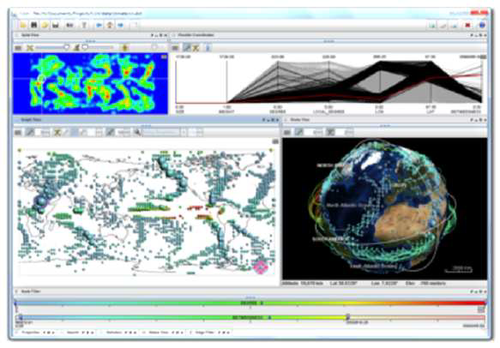
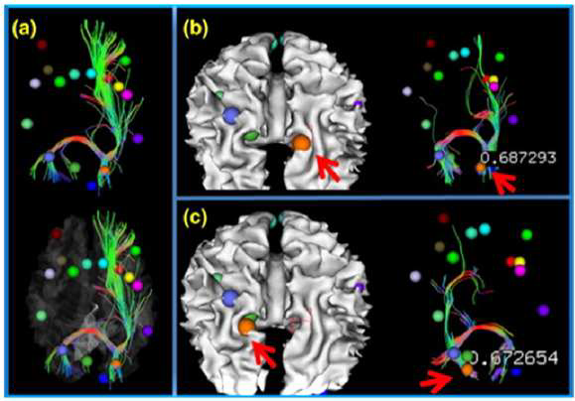
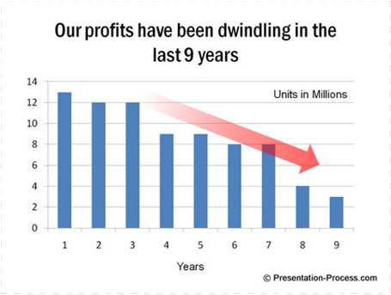
Need for Data Visualization
Tool to enable a user get insight into data
Broadly three types of goals:
• To explore:
Nothing is known
Required to get an insight
To analyze :
There are hypotheses
Used for verification or falsification
To present:
We have the required information
Used for communication of result
Source: Google images

Slide 58
What experts say ?
“Data visualization is the use of visual representations to explore, make sense of, and communicate data.”
Data visualization expert, Stephen Few
Visualization transforms data into images that effectively and accurately represent information about the data.
– Schroeder et al. The Visualization Toolkit, 2nd ed. 1998
Turning invisible into visible that people can understand intuitively
58
Notes:
58

Slide 59
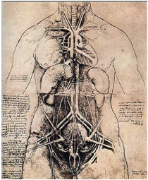
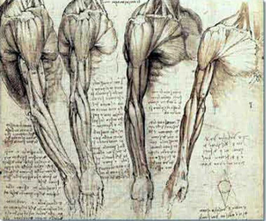
History of Visualization
Visualization : Very old
L . Da Vinci (1452 – 1519)
Often an intuitive step: graphical illustration
Image source: http://www.leonardo-da-vinci-biography.com/leonardo-davinci-anatomy.html
59
Notes:
59

Slide 60
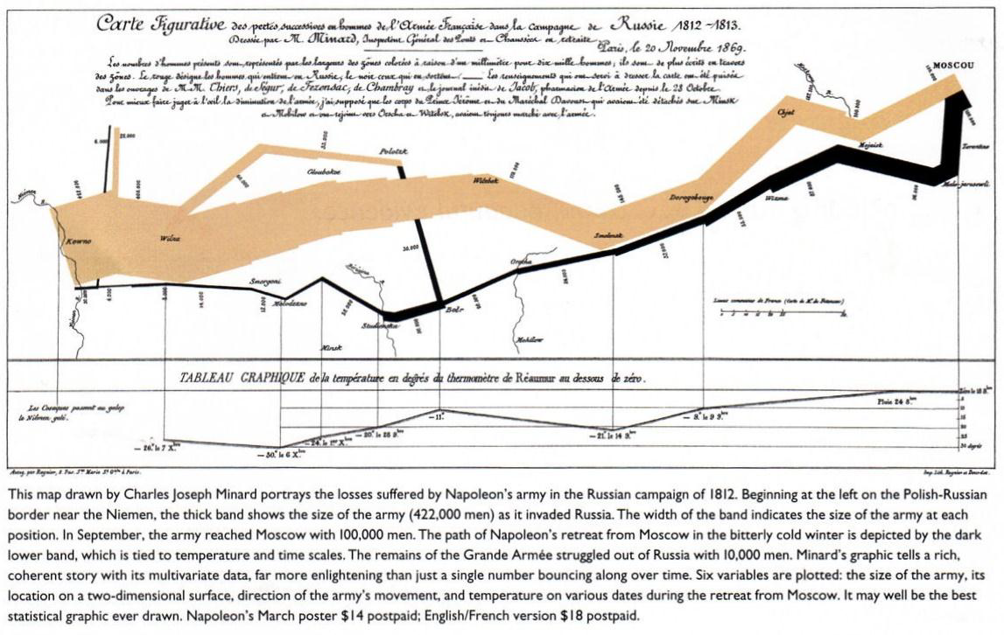
Visualization of Napoleon's Army

Slide 61
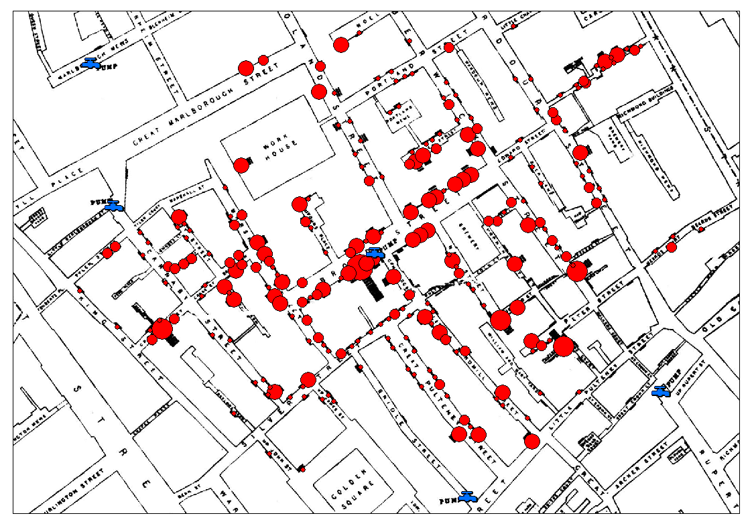
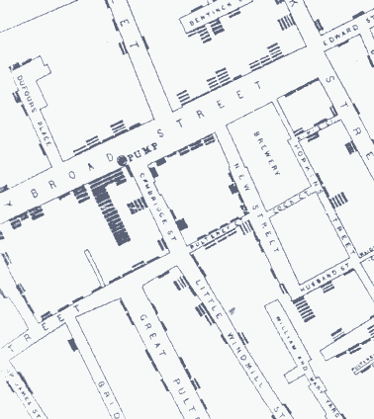
Impact of Visualization
John Snow’s Cholera Map (1854)
Snow used a spot map to illustrate how cases of cholera clustered around the pump
61
Notes:
61

Slide 62
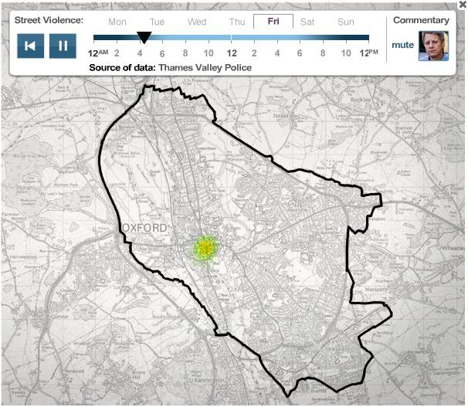
Truth about Crime – BBC
http://www.bbc.co.uk/truthaboutcrime/crimemap/

Slide 63
Good data representation principles
Exercise:
Breakout into groups of two and identify five good data visualization principles
–5 minutes

Slide 64
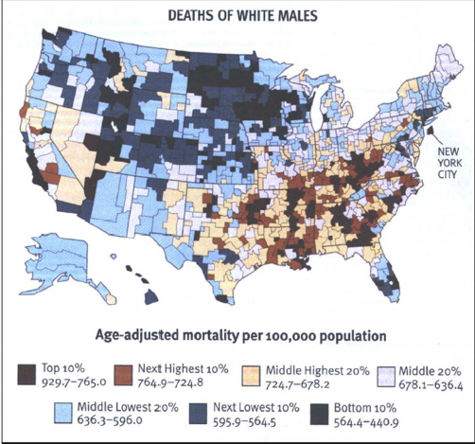
1. Use Colors Wisely – 1/5
What is Wrong with this Color Scale ?

Slide 65
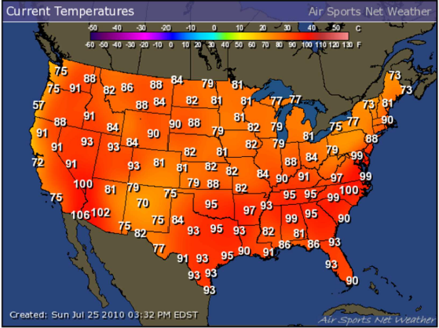
1. Use Colors Wisely -2/5
Not a bad choice of color scale, but the Dynamic Range needs some work

Slide 66
Do Not Attempt to Fight Pre-Established Color Meanings
1. Use Colors Wisely – 3/5
Red
Stop
Off
Dangerous
Hot
High stress
Oxygen
Shallow
Money loss
Project running late
Green
Go
On
Plants
Carbon
Moving
Money
All OK
SLA Met
Project on schedule
Blue
Cool
Safe
Deep
Nitrogen
Job completed

Slide 67

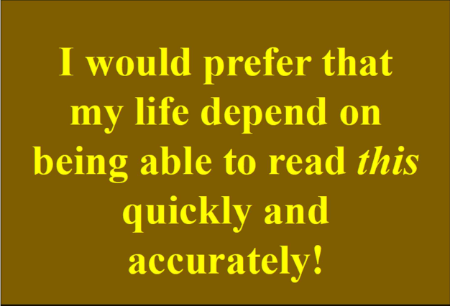
Use good contrast as human eye is good at difference NB : Could you also spot a grammatical error in above ?
2. Use Colors Wisely – 4/5
Which one is easier to read ?

Slide 68
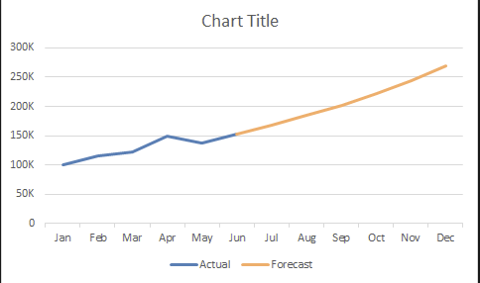
Just because there are million of colors to chose from does NOT mean that you have to use them all
1. Use Colors Wisely – 5/5
Avoid Color Pollution
Use a different color to extrapolation to future

Slide 69
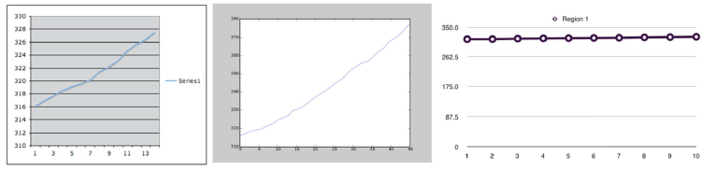
Three graphs from the same data
2. Reduce clutter
Why are they all different ?
What is good/ bad about each one of them ?

Slide 70
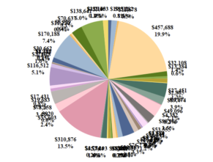
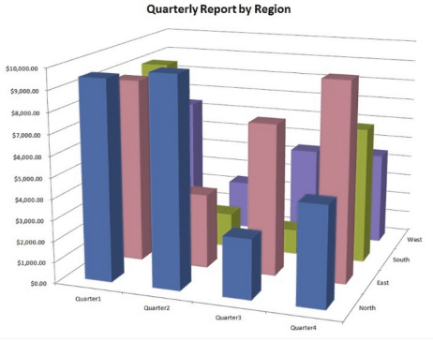
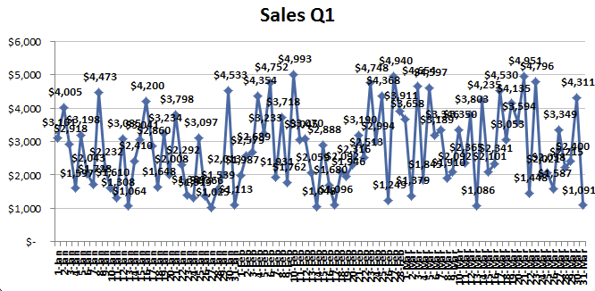
2. Reduce Clutter
Can you draw inferences from these charts ?
Make your data stand out, by reducing the clutter

Slide 71
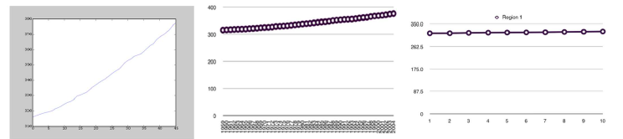
Use visually prominent graphical elements to show the data
3. Improving the Vision
Connecting lines should never obscure points and points should not obscure
each other.
If multiple samples overlap, a representation should be chosen for the
elements that emphasizes the overlap.
If multiple data sets are represented in the same plot (superposed data), they must be visually separable.
If this is not possible due to the data itself, the data can be separated into
adjacent plots that share an axis

Slide 72
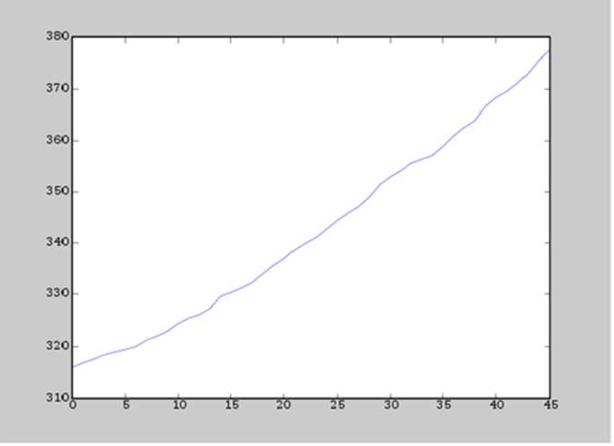
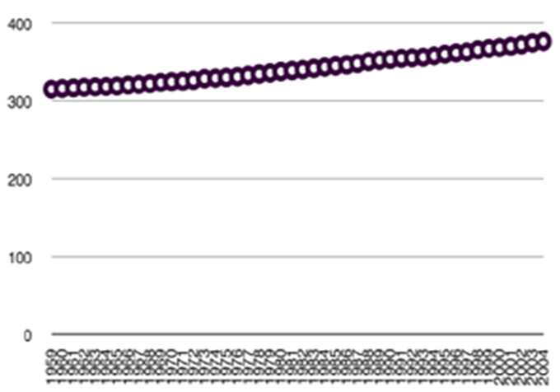
Choice of proper scale decipher the trend easily
4- Use proper scale
Horizontal and vertical axes must be labeled, or data points labeled.
Add margins for data
Tick-marks outs and 3-10 for each axis

Slide 73

Use reference lines, labels, notes, keys et only when necessary and don’t let them obscure data.
5- Reference lines, labels, notes

Slide 74

Make sure that scales match and graphs are aligned, to improve the understanding
6- Align juxtaposed plots

Slide 75
Gestalt principles
The brain creates a perception that is more than the sum of available visual inputs.
Gestalt principles is used to identify the elements in our visualization which are signal (the information we want to communicate) and which are noise (clutter).
Six Gestalt principles are as follows:
Proximity
Similarity
Closure
Enclosure
Continuity
Connection
Notes:
Initial research was carried out in early 1900s, and the first group of psychologists were Johann Wolfgang von Goethe, Ernst Mach, Christian von Ehrenfels, Max Wertheimer, Wolfgang Kohler, Kurt Koffka and Kurt Lewin.
Gestalt principles of visual perception describe how our mind organizes individual visual elements into groups, to make sense of the entire visualization.

Slide 76

Law of Proximity
We perceive objects close to each other as belonging to a group.

Slide 77

Law of Similarity
We seek similarities and differences in objects and link similar objects as belonging to a group.

Slide 78

Law of Closure
Our minds tend to see complete figures even if a picture is incomplete.

Slide 79

Law of Enclosure
We perceive objects as belonging to a group when they are enclosed in a way that creates a boundary or border around them.

Slide 80

Law of Continuity
Our tendency is to see shapes as continuous to the greatest degree possible. The human eye follows lines, curves or a sequence of shapes to create pathways.

Slide 81

Law of Connection
We perceive objects connected to each other as a single group as opposed to objects that are not linked in the same manner.

Slide 82

Are you ready to create a dashboard ?

Slide 83




Dashboard

Slide 84







Elements of dashboard design
Chart type

Slide 85
Steps for a great dashboard design
Content
Know your target audience
Who is the audience? Their need?
Relationship with presenter? 1st time or established trust?
Face to face or connected remotely?
Identify the content they will be looking for
What the audience is expected to learn?
Key takeaways and next steps
Tools

Slide 86


Steps for a great dashboard design
Avoid excessive details

Slide 87

Chart Types
Line charts are great when it comes to displaying patterns of change across a continuum.

Slide 88

Chart Types
Choose bar charts if you want to compare items in the same category.
The objective is not just to compare but also show how much one is better or worse than the rest.

Slide 89

Chart Types
Sparklines usually don’t have a scale which means that users will not be able to notice individual values. They work well when you have a lot of metrics and you want to show only the trends.

Slide 90

Charts To Avoid
Avoid scatterplots. They lack precision and clarity as the relationships between two quantitative measures don’t change very frequently.

Slide 91

Charts To Avoid
Avoid Pie charts. They rank low in precision because users find it difficult to accurately compare the sizes of the pie slices.

Slide 92

Charts To Avoid
Avoid bubble charts. They require too much mental effort from their users even when it comes to reading simple information in a context.

Slide 93

Visualization and layout design
Place the most important information of top left of the dashboard.
Reason – Humans follow F shaped visual scanning path.

Slide 94
Visualization and layout design
Avoid highly saturated colors instead choose few colors and stick to it.
Use the same color for the same item on all charts.
Use colors (or encircle it) to highlight the target data

Slide 95

Some tools that aid in data visualization include: - Tableau - Power Point - QlikView - Python Visualization library (MatPlotlib) - Google chart and so on

Slide 96
Any question ?
Thank You
96
Notes:
25-07-2013
TA ZC164
96

Slide 97

Data Has Become ‘Big ’
“The purpose of visualization is insight, not just picture.”
Data visualization pioneer, Ben Shneiderman
Source: http://houseofbots.com

